Slide 1
Bird species classification
Team Name:- Tech AI
Team Number:- 4
Team Members:-
Puneet Chauhan 2210990691
Rahul Choudhary 2210990703
Parv Kapoor 2210990646
Priyanshu Gupta 2210990687

Slide 2
Index
Objective
Introduction
Methodology & Techniques
Flow Chart
Source Code (screenshots)
Result
Conclusion
Reference

Slide 3
Objective
To identify the bird species there are many websites produces the results using different technologies.
But the results are not accurate. Suppose if we
give an input in those websites and android applications it gives us multiple results instead of single bird name. It shows us the all bird names which are having similar characteristics. So, we aimed to develop a project to produce better and accurate results.

Slide 4
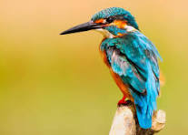
INTRODUCTION
Bird conservation is increasingly crucial in maintaining ecological balance and biodiversity. However, accurately identifying bird species remains a challenge for
researchers and conservationists. Leveraging advanced machine learning techniques, our project aims to develop a predictive model for automated bird species identification.

Slide 5
METHODOLOGY & Technique
Data Collection: Gather diverse datasets of bird-related information, including images, sounds, and environmental variables. Ensure data quality and diversity to capture a wide range of bird species and habitats.
Data Preprocessing: Clean the dataset by handling missing values, encoding categorical variables, and normalizing numerical features to ensure consistency and reliability.
Exploratory Data Analysis (EDA): Explore the dataset to understand the distribution and relationships between variables. Visualize key features and variables using histograms, scatter plots, and heat maps to identify potential correlations and outliers.
Model Selection: Choose appropriate machine learning algorithms for classification tasks, such as logistic regression, decision trees, random forests, or support vector machines.
Model Training: Split the dataset into training and validation sets. Train the selected models using the training data and optimize hyperparameters to improve performance.

Slide 6
Flowchart
Data Collection
Data Preprocessing
Exploratory Data Analysis
Model Selection
Model Training
Monitoring and Maintenance
Deployment
Validation and Testing
Model Evaluation

Slide 7
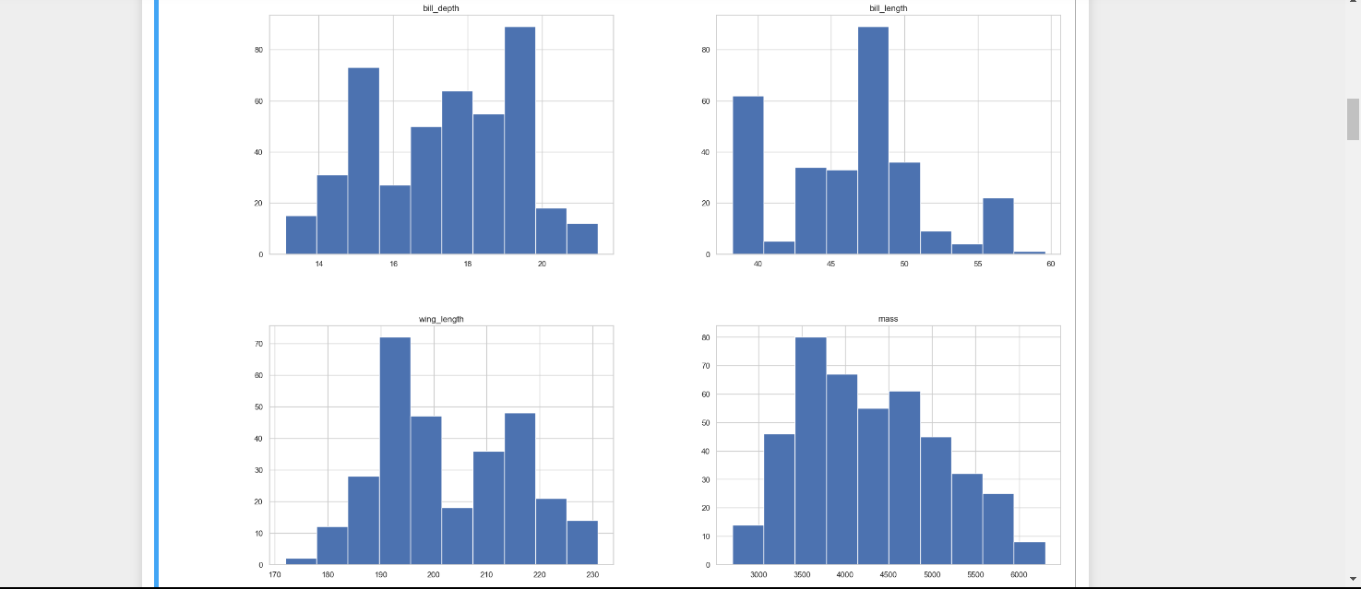
Source code

Slide 8
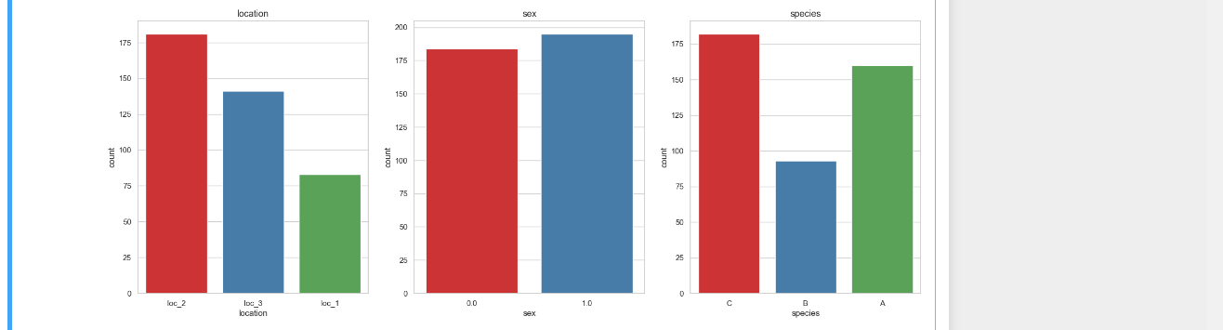

Slide 9
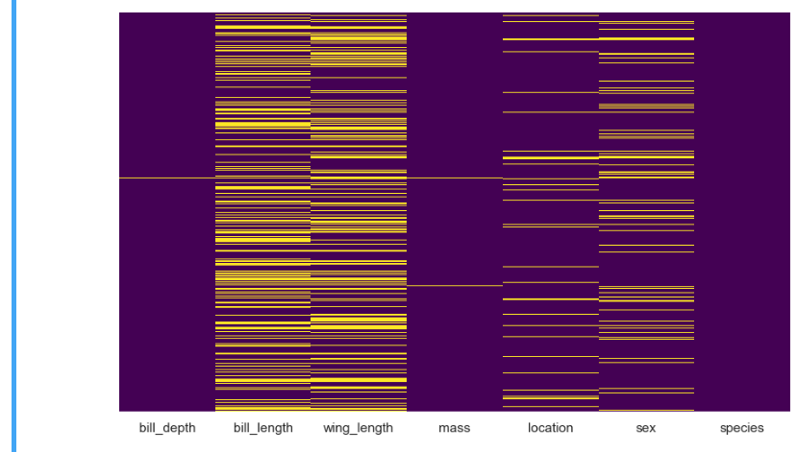

Slide 10
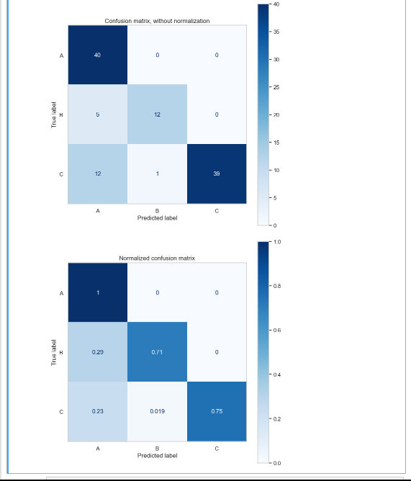

Slide 11
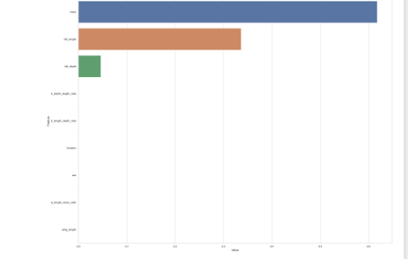
Result

Slide 12
Conclusion
In conclusion, our project represents a pioneering effort in the application of machine learning to bird species prediction. By harnessing the power of data-driven approaches, we aim to advance our understanding of avian ecology and facilitate more targeted conservation efforts. We look forward to sharing our findings and contributing to the global effort to protect and preserve bird species worldwide.

Slide 13
Refrence
https://towardsdatascience.com/bird-species-classification-with-machine-learning-914cbc0590b

Slide 14
THE END

